Slide 1

Web Development
Session 3

Slide 2
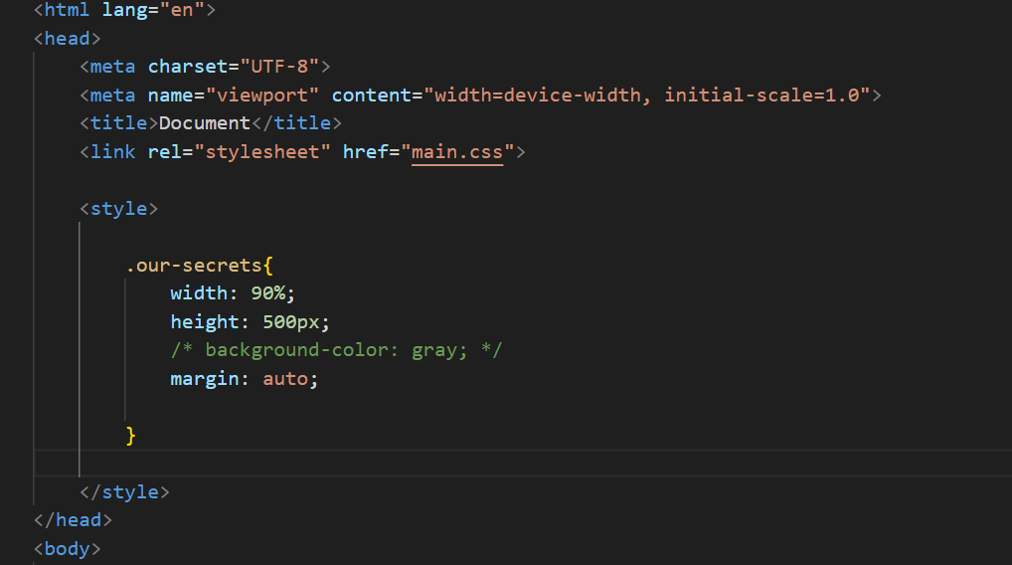
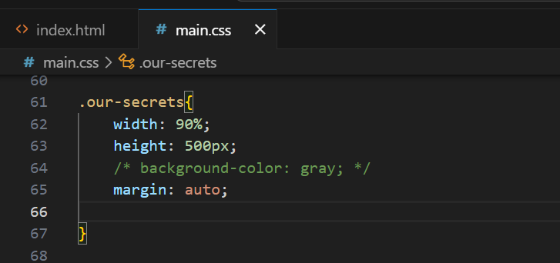
Web Development
Session 3
inline, internal, external
internal
inline
external

Slide 3
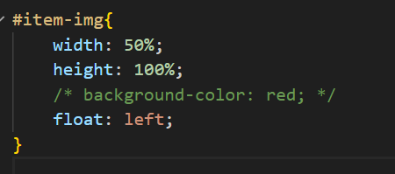
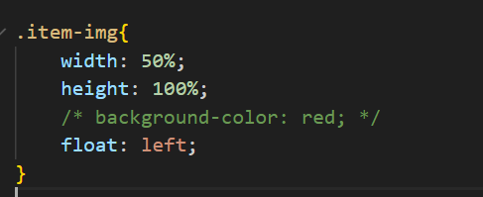
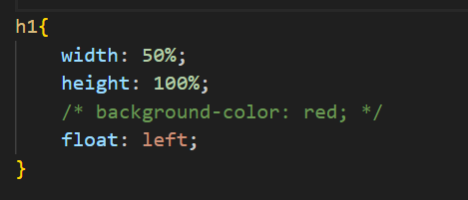
Web Development
Session 3
id, class, tag name
id
class
Tag name

Slide 4
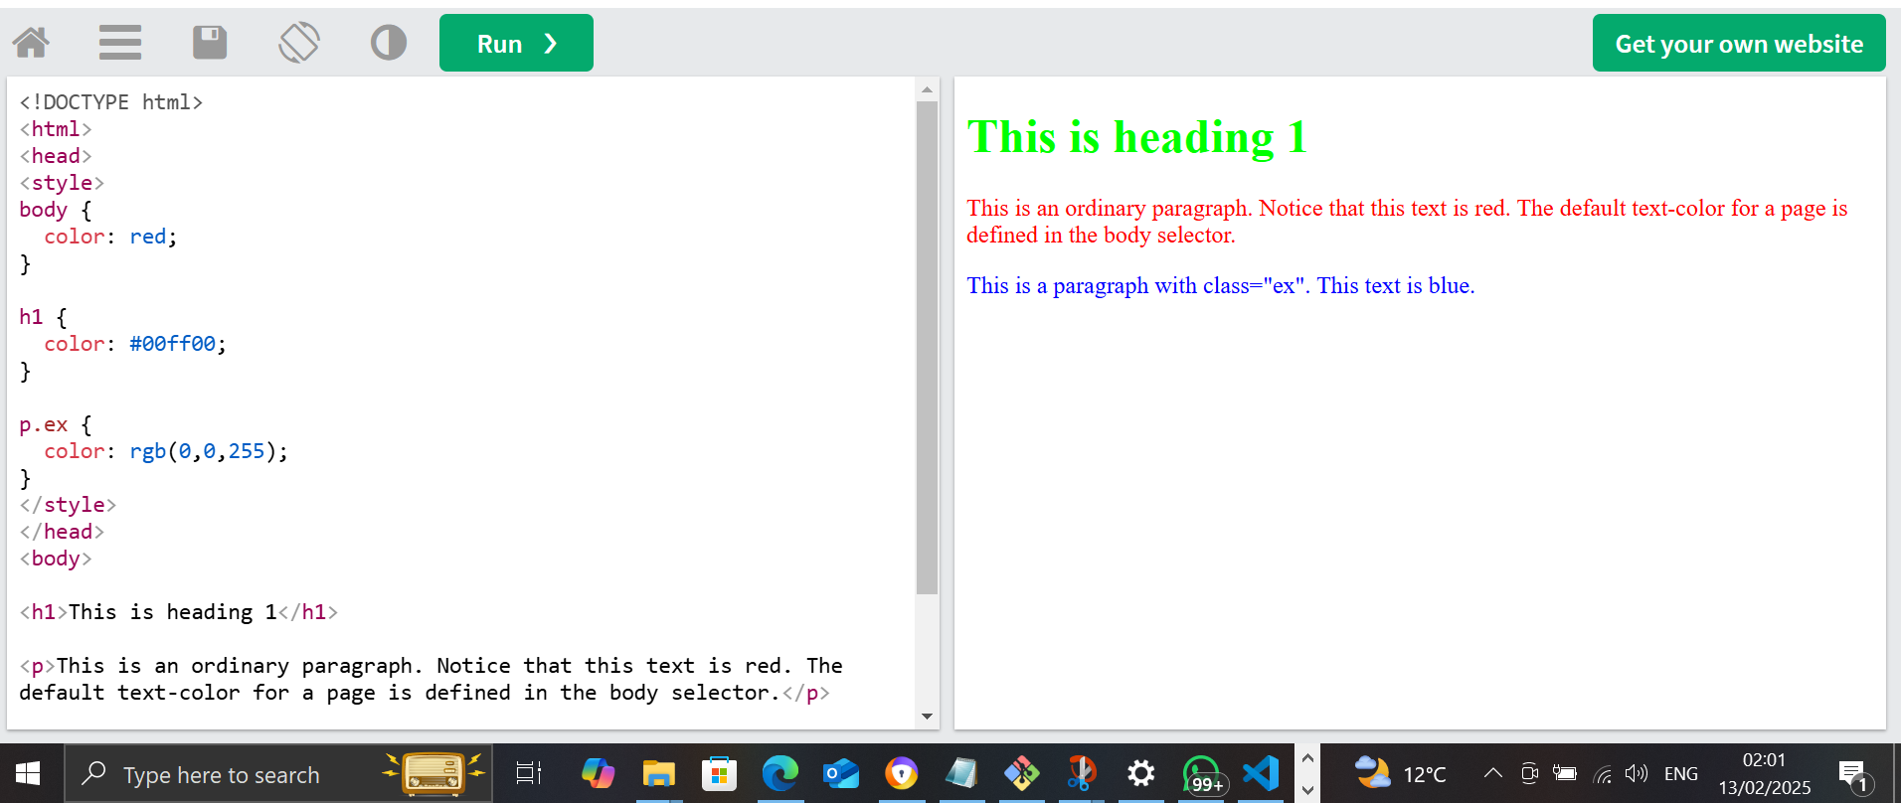
Web Development
Session 3
Background-color

Slide 5
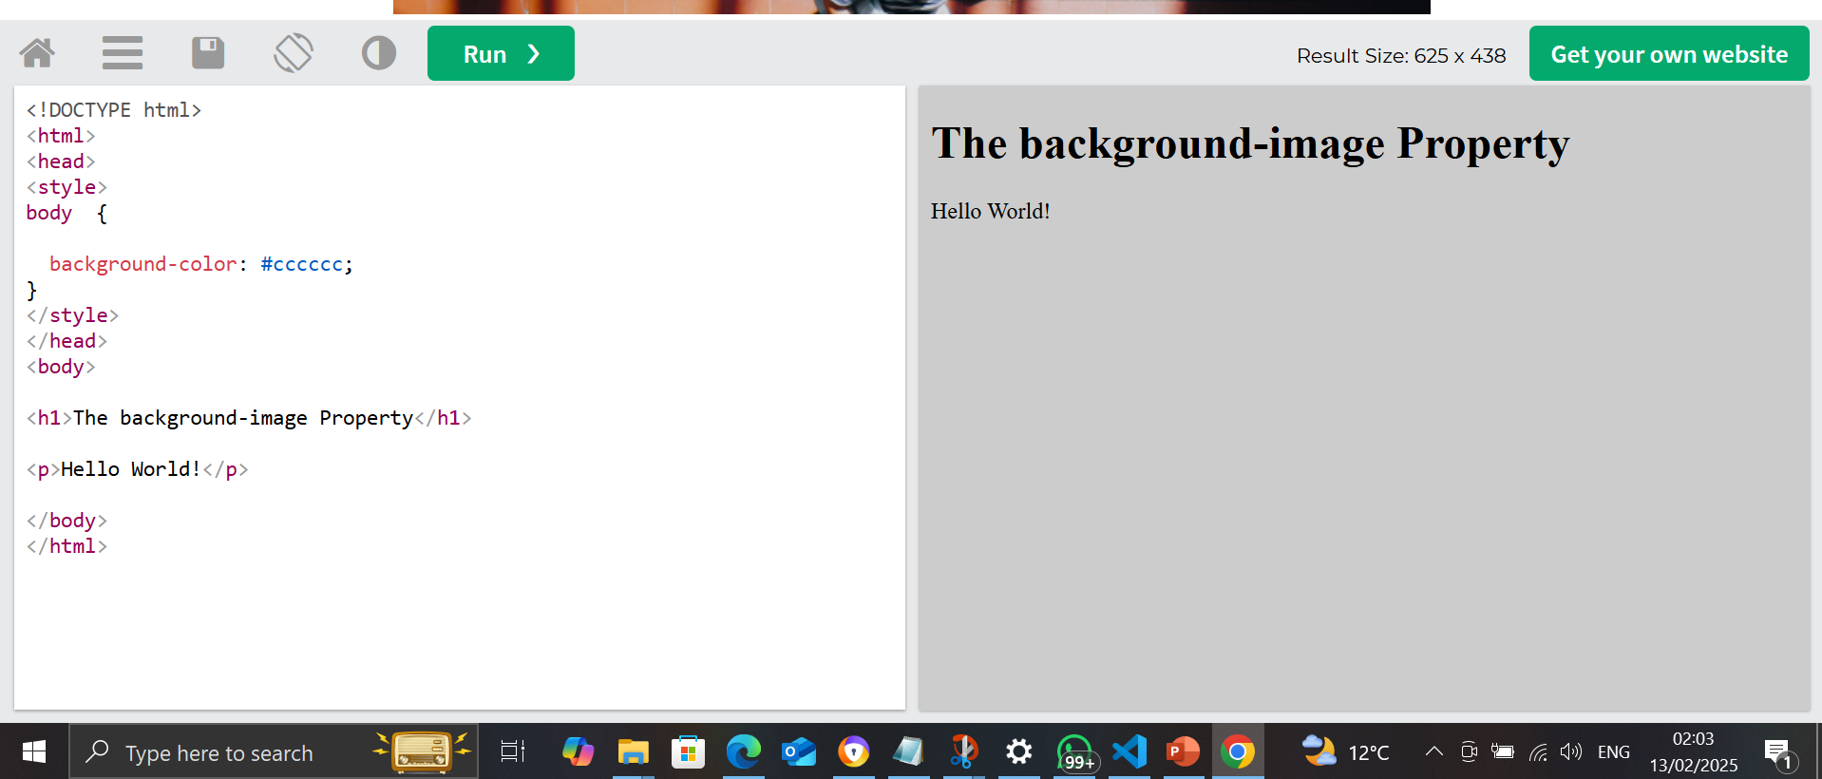
Web Development
Session 3
background

Slide 6
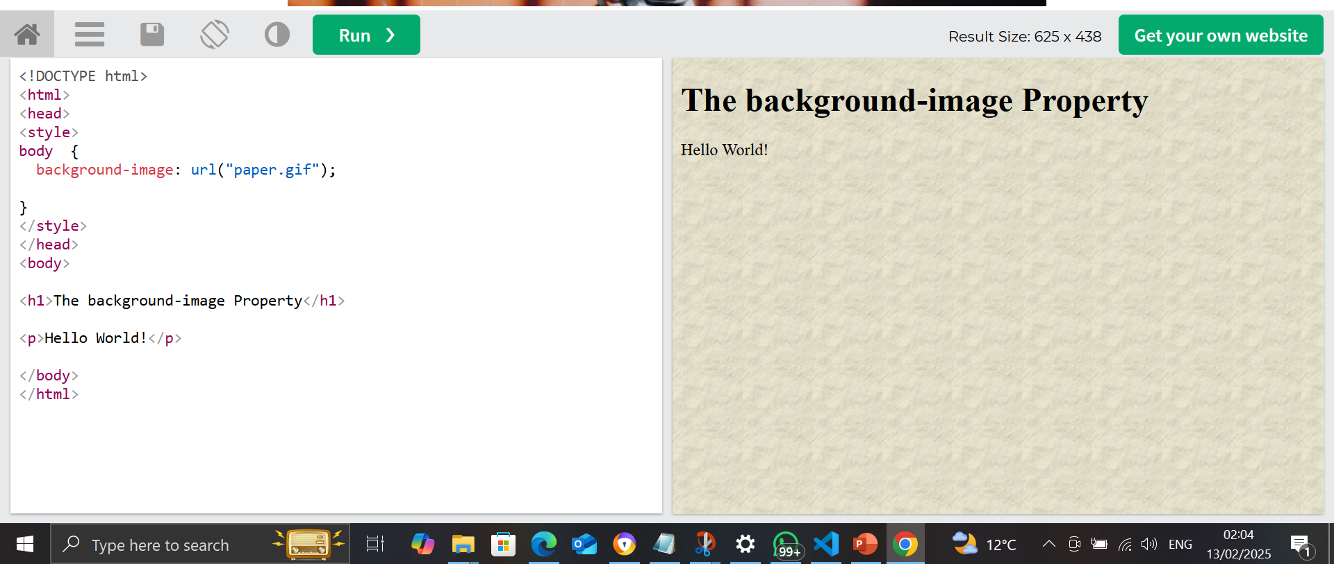
Web Development
Session 3
Background-image

Slide 7
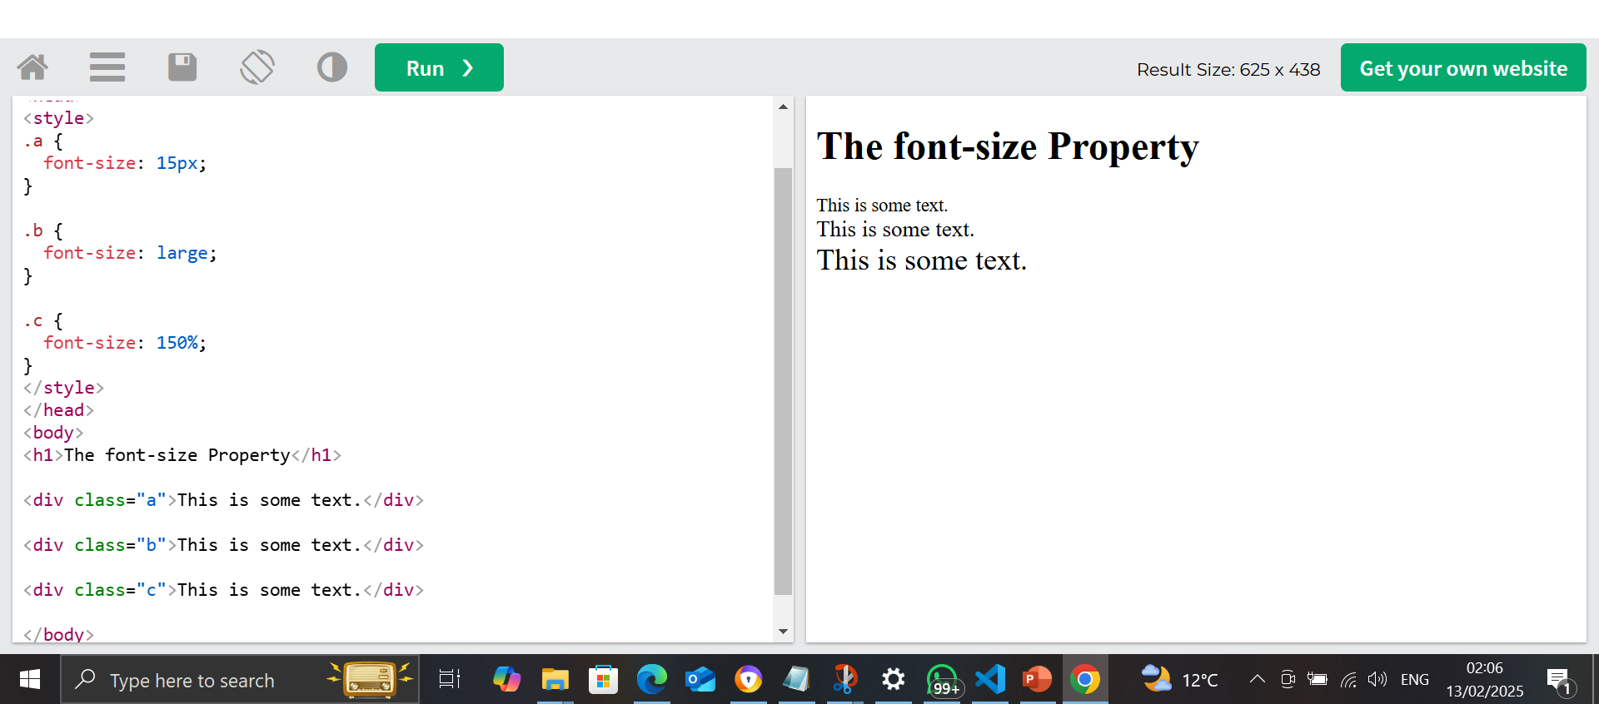
Web Development
Session 3
font-size

Slide 8
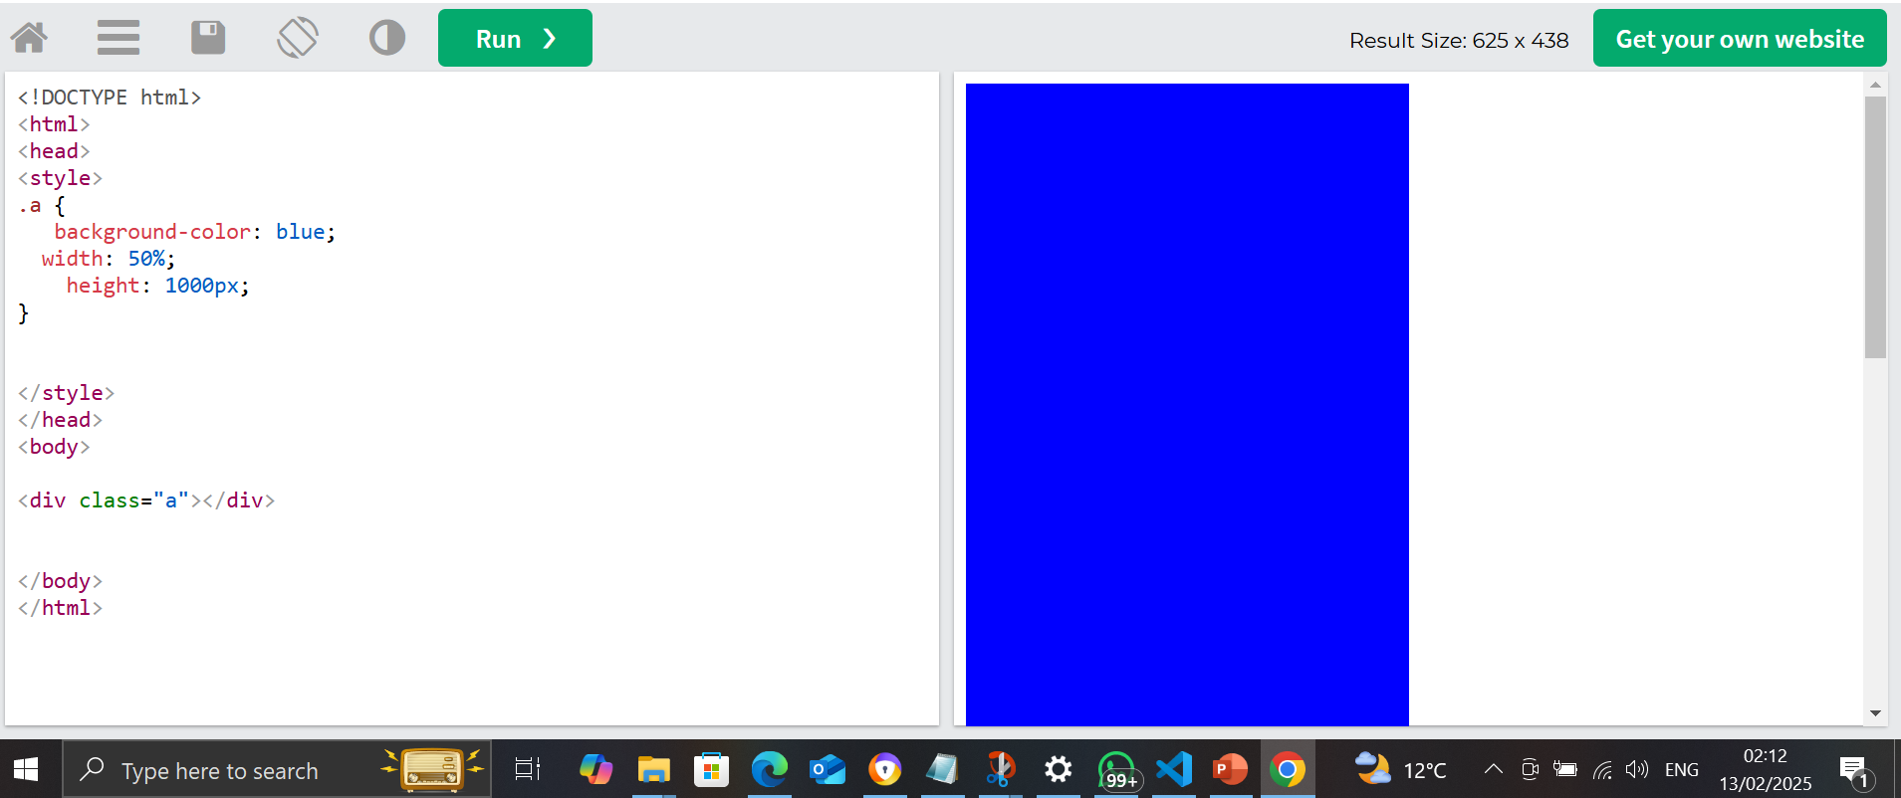
Web Development
Session 3
width,hight

Slide 9
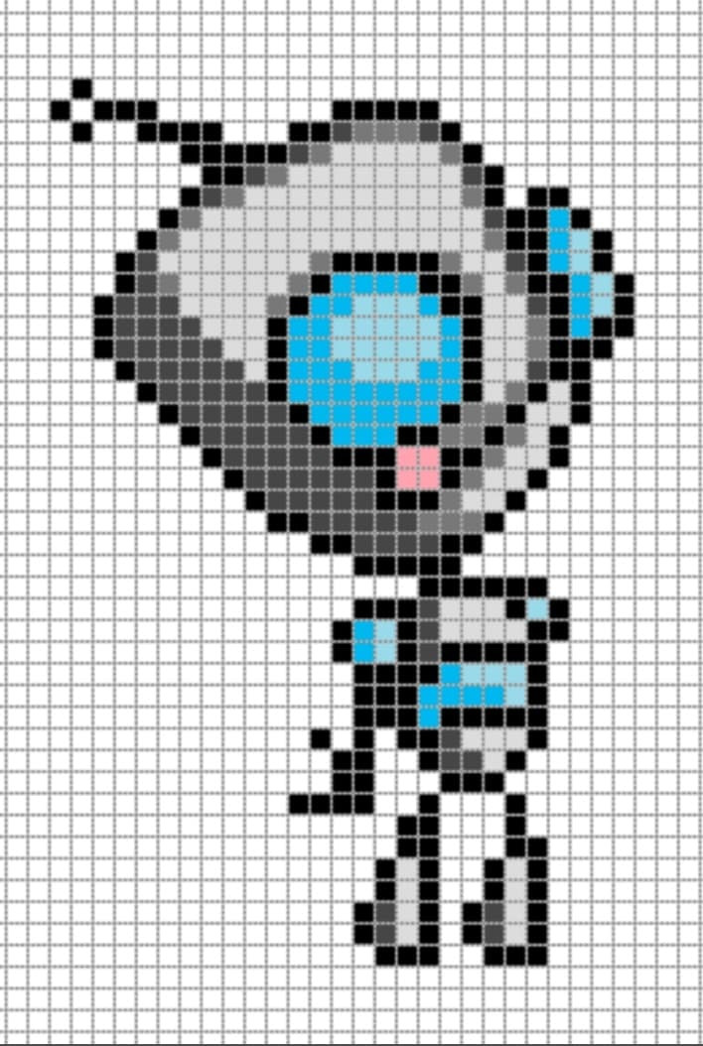
Web Development
Session 3
Px?

Slide 10
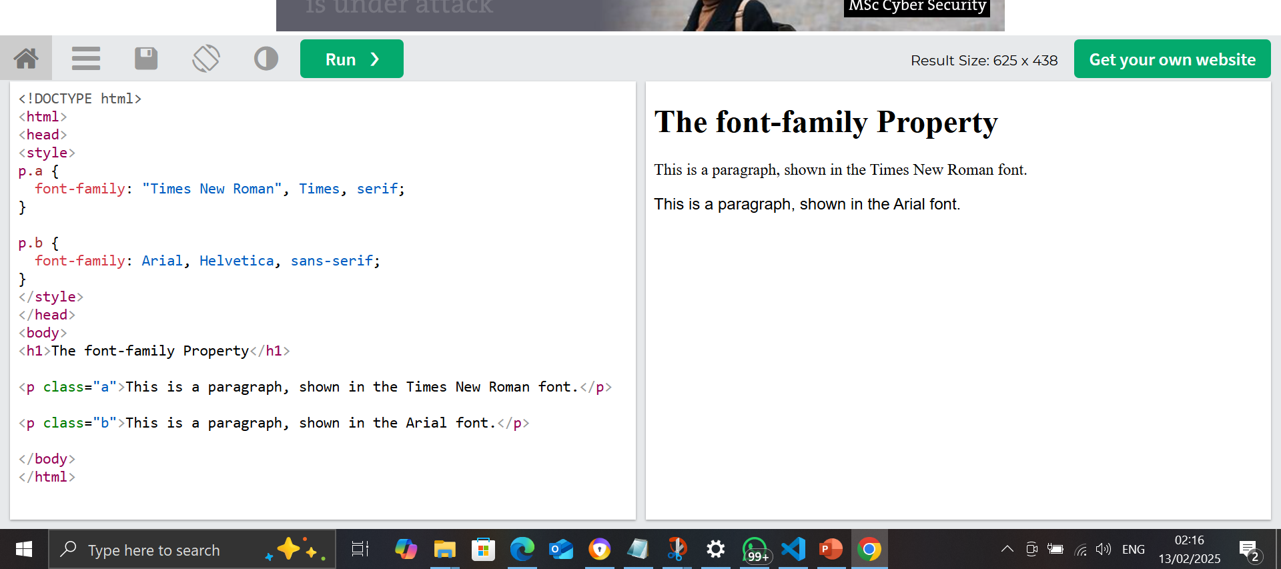
Web Development
Session 3
Font-family

Slide 11
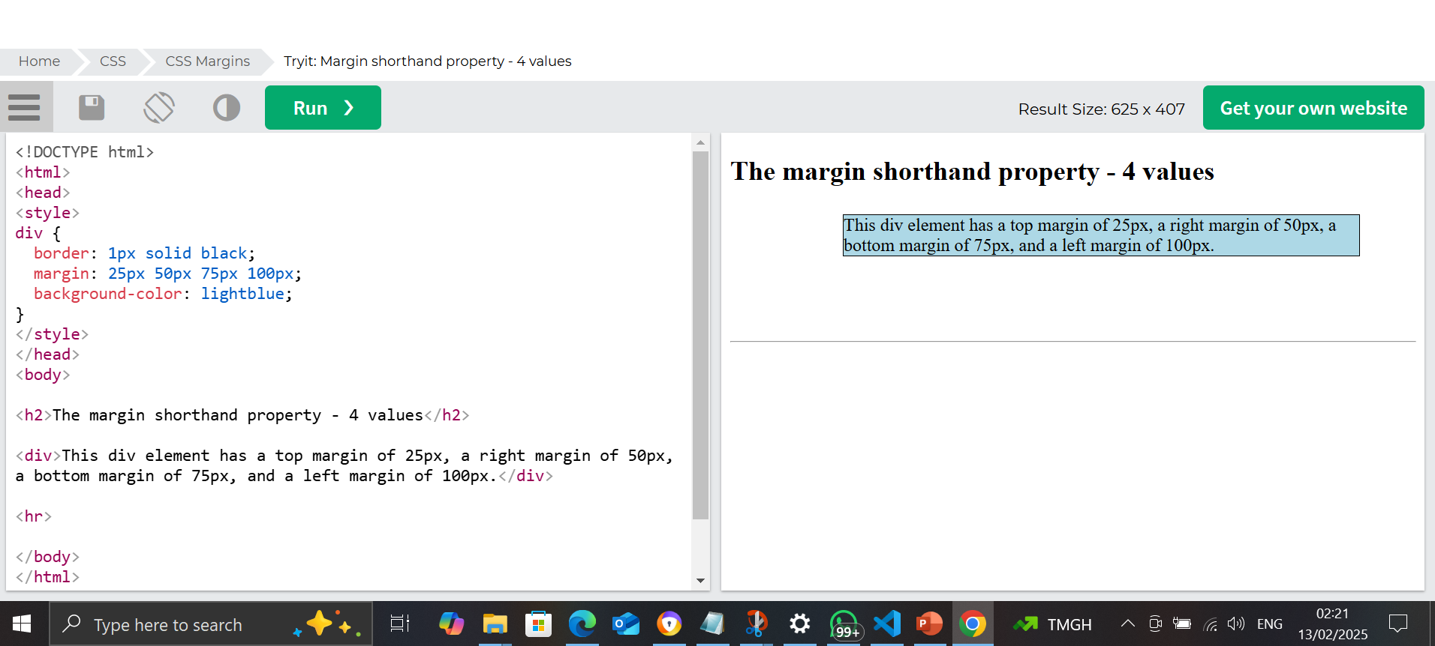
Web Development
Session 3
margin

Slide 12
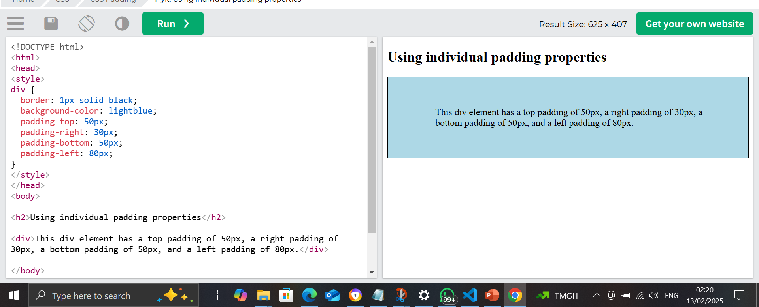
Web Development
Session 3
padding

Slide 13
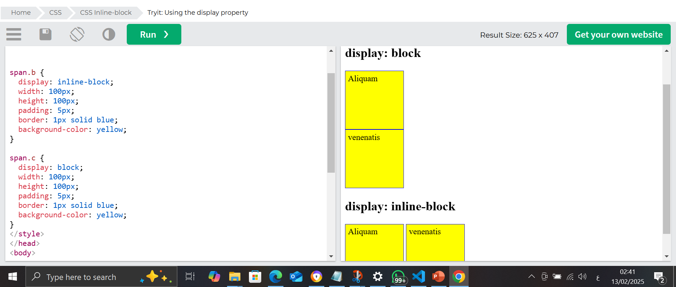
Web Development
Session 3
Display = block or inline-block

Slide 14
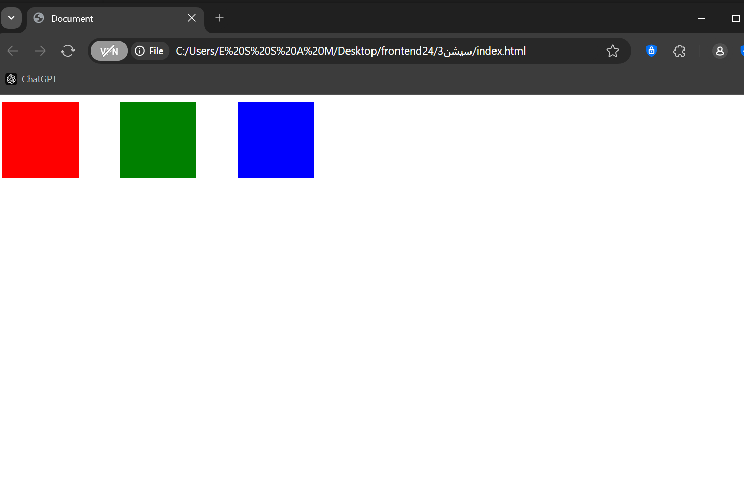
Web Development
Session 3
task

Slide 15
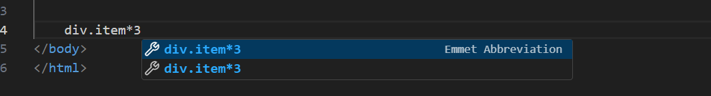
Web Development
Session 3
Emmet ,div.item*3

Slide 16
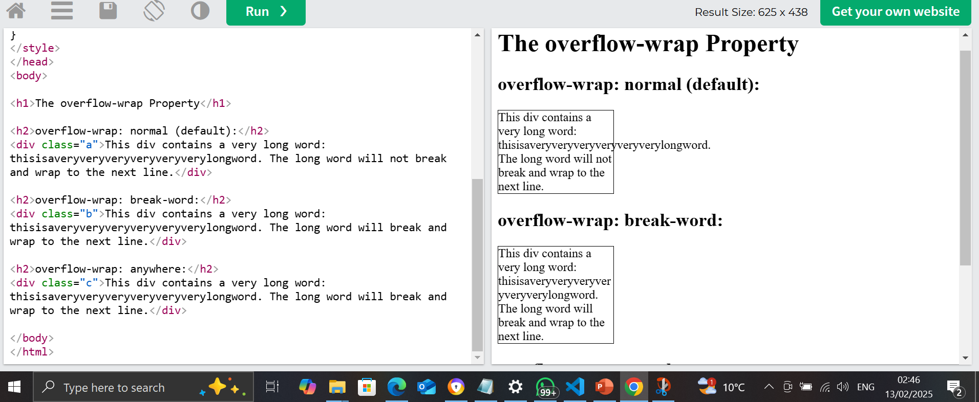
Web Development
Session 3
overflow-wrap: break-word;

Slide 17
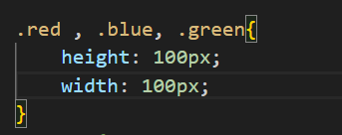
Web Development
Session 3
groubing css .red , .green, .blue

Slide 18
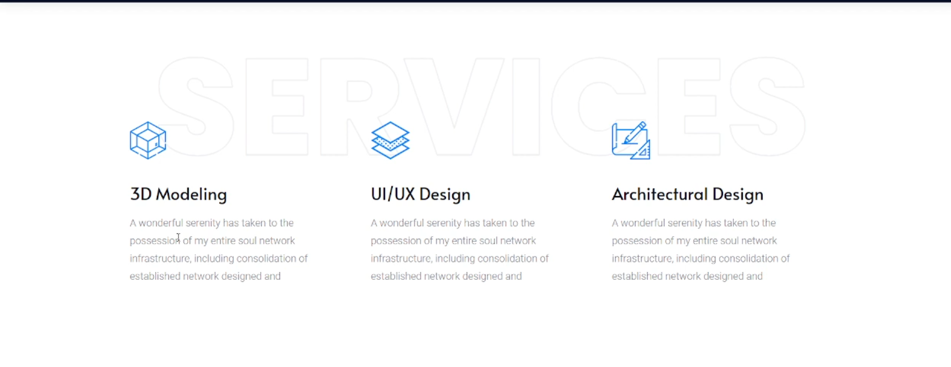
Web Development
Session 3
Task 2

Slide 19
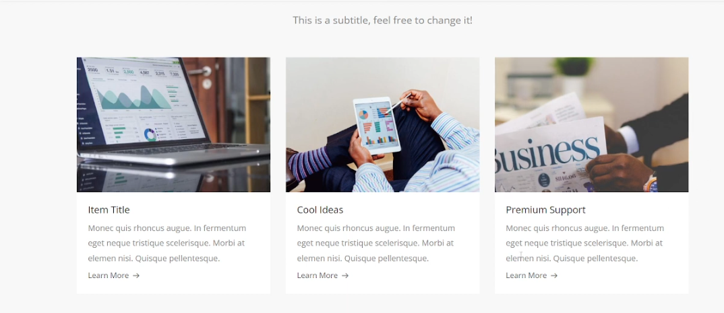
Web Development
Session 3
Task 3

Slide 20

Web Development
Session 3
Task 4

Slide 21
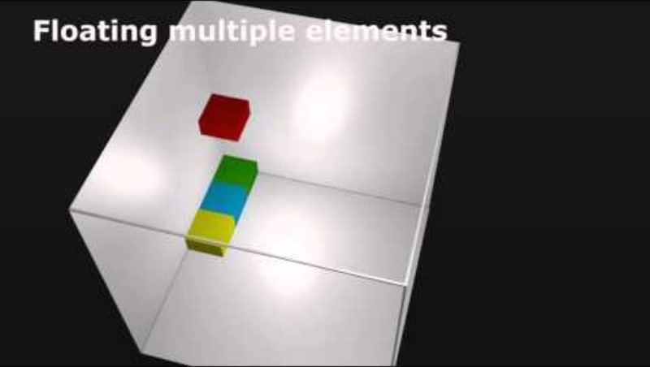
Web Development
Session 3
flaot

Slide 22
Web Development
Session 2
CSS chapter 2
To Be Continued ..

